Slide 1
Crime Trends in Austin: Seasonal Insights from 2003 to 2023
By: Julie, Prashant and Sarah

Slide 2
Resources
CSV Source: https://data.austintexas.gov/Public-Safety/Crime-Reports/fdj4-gpfu/about_data

Slide 3
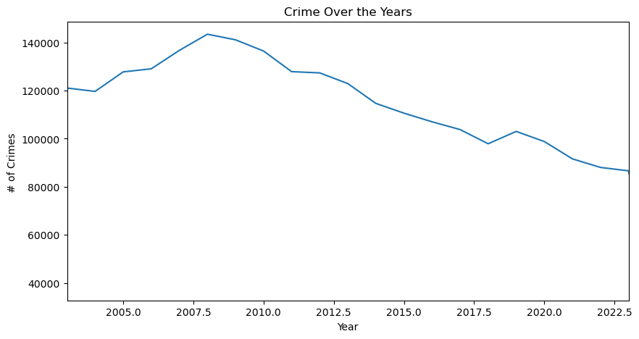
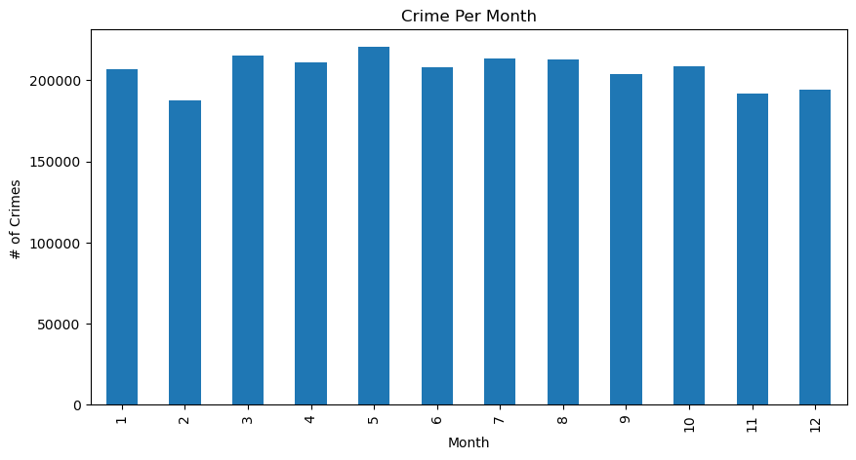
Basic Analysis
Has crime gone up or down over the last 20 years in Austin, TX?
Does there seem to be a trend in crime by month?

Slide 4
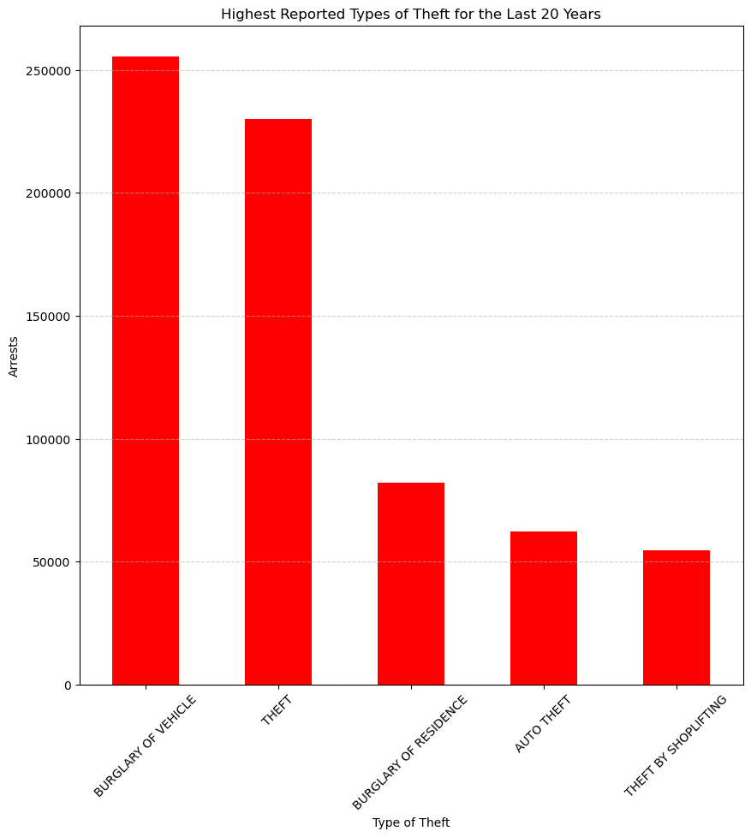
Basic Analysis cont.
Which types of theft crimes were reported the most?
We are going to perform Chi Square Tests, so we need to find the Critical Value
Critical Value = 7.8147279032511

Slide 5
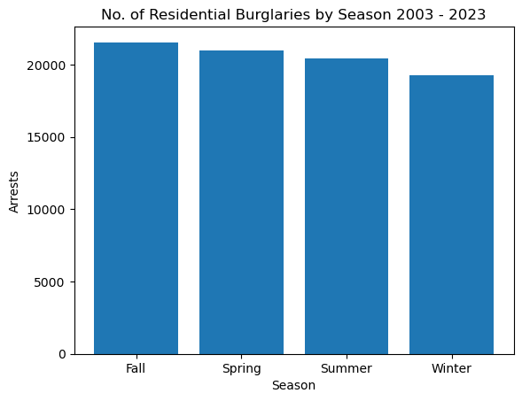
Residential Burglaries by Season
Looks to be less in the Winter
Chi-Square Statistic: 68.10559048133163
P-value: 1.0860061995797653e-14
With a very high Chi-Square value and a very low P-value→ this tells us that we can reject the null hypothesis and say..
SEASON COULD DEFINITELY BE AFFECTING THE NUMBER OF RESIDENTIAL BURGLARIES

Slide 6
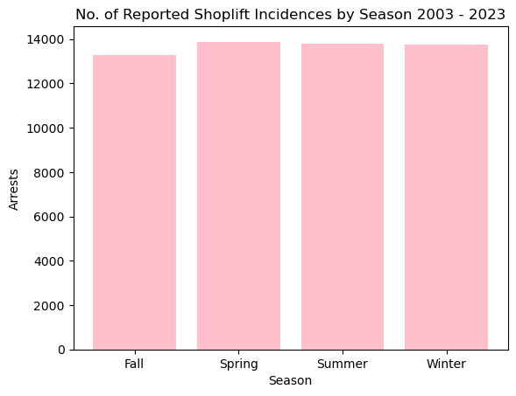
Shoplifting By Season
Pretty even from the naked eye, but maybe less in the fall
Chi-Square Statistic: 8.155594276196815
P-value: 0.04290314382794721
While the Chi-Square is a lot closer to Critical Value compared to the other tests, P-value is still below 0.5. Still reject Null Hypothesis

Slide 7
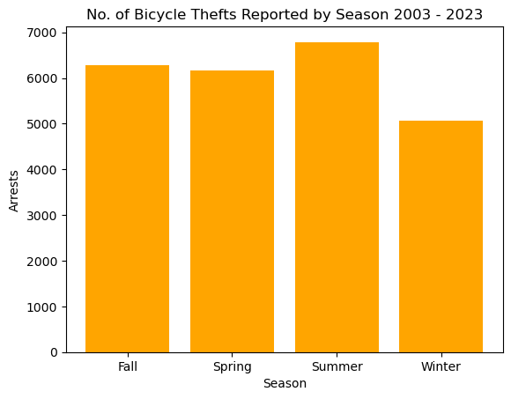
Bicycle Thefts
LOW IN THE WINTER
HIGH IN THE SUMMER
Chi-Square Statistic: 133.9015818401975
P-value: 7.801563909349704e-29
With a very high Chi-Square value and a very low P-value→ this tells us that we can reject the null hypothesis and say..
SEASON COULD DEFINITELY BE AFFECTING THE NUMBER OF RESIDENTIAL BICYCLE THEFTS

Slide 8
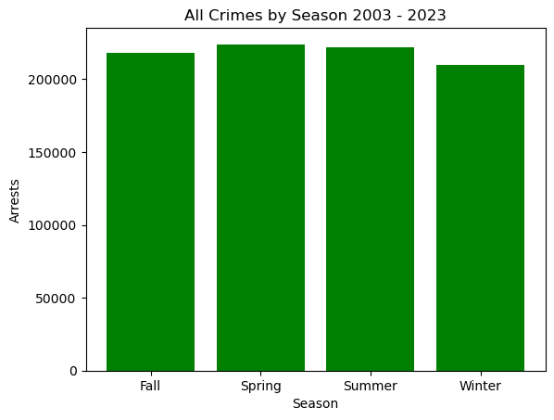
ALL CRIMES BY SEASON CHI SQUARE TEST
Chi-Square Statistic: 280.6044358946858
P-value:
1.566923504984882e-60
REJECT NULL HYPOTHESIS
This means.. Season could be having an impact on crime rate as a whole!!

Slide 9
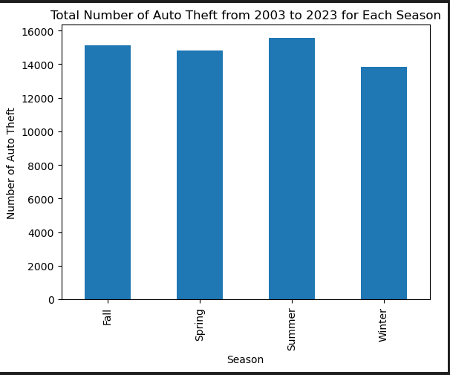
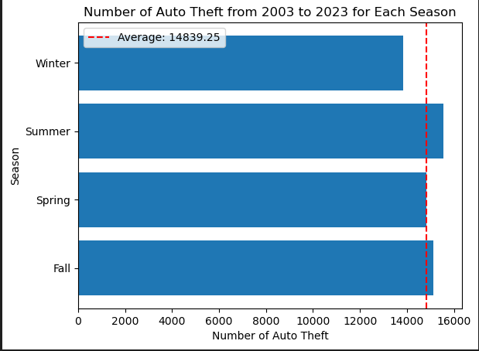
Overall and Averages Data of Auto Theft

Slide 10
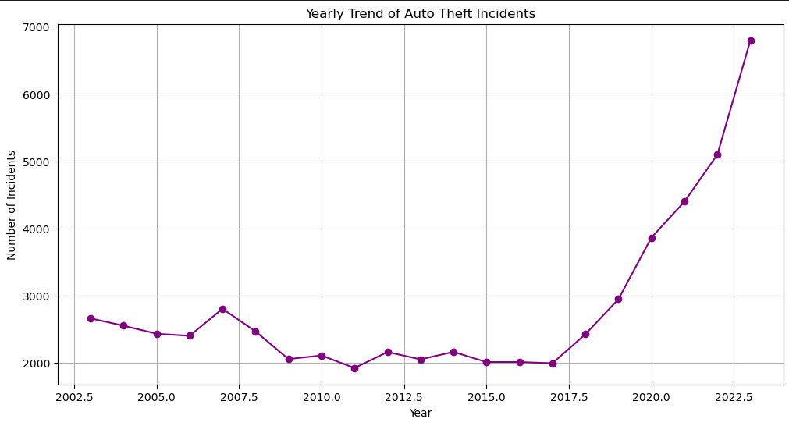
Overall Trend Over 20 Years

Slide 11
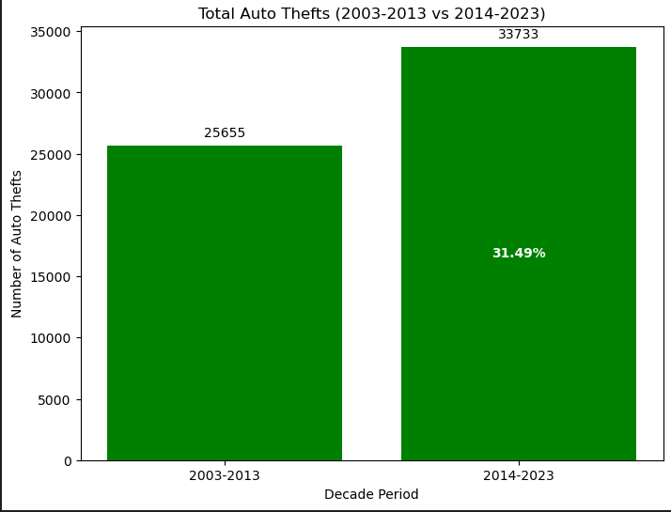
Increase in Number of Occurrences Compared to Previous Decade

Slide 12
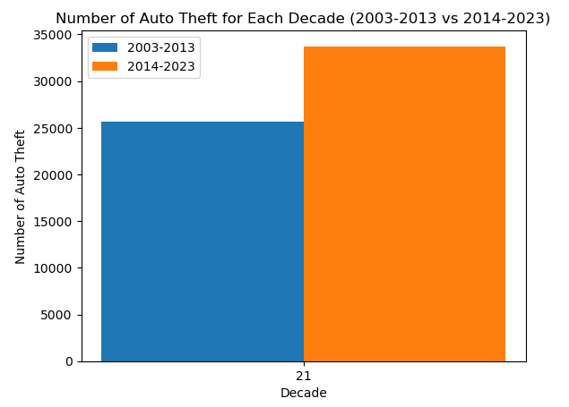
Auto Theft Over the Decades
33733
25655
31.49%

Slide 13
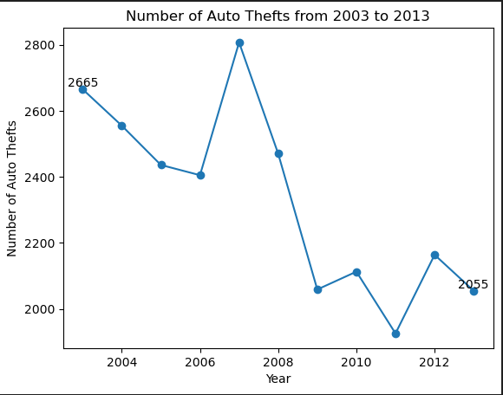
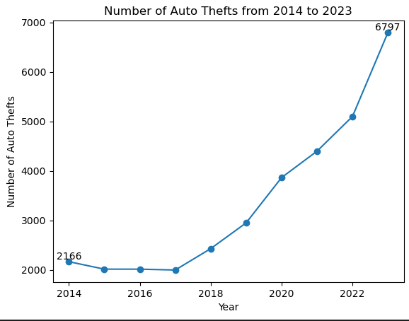
Comparison of Occurrences Between Two Ten Year Periods
Auto Thefts Between 2003-2013 -22.89% of 25,655 Total Occurrences
Auto Thefts Between 2014-2023 +213.80% of 33,733 Total Occurrences

Slide 14
Test 4: Auto Theft across Seasons
N0: If seasons are not related to Auto theft, then particular seasons will not see an increase in identity theft.
N1: If seasons are related to auto theft, then particular seasons will show an increase in identity theft.
Results:
Chi-squared test:
P-value:
Reject null hypothesis: Seasons do influence auto theft

Slide 15
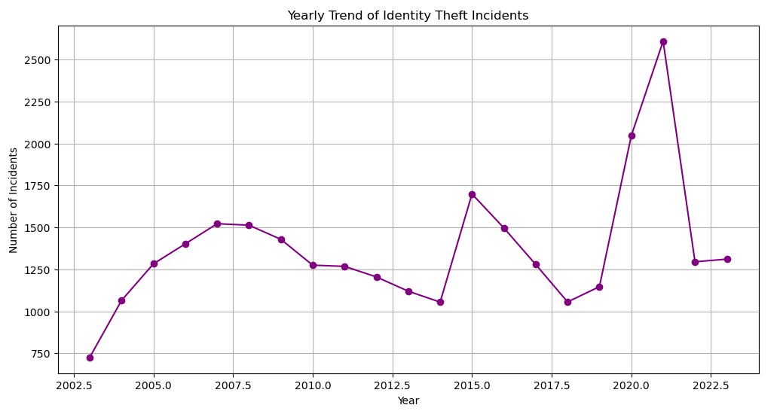
Identity Theft Over the Years

Slide 16
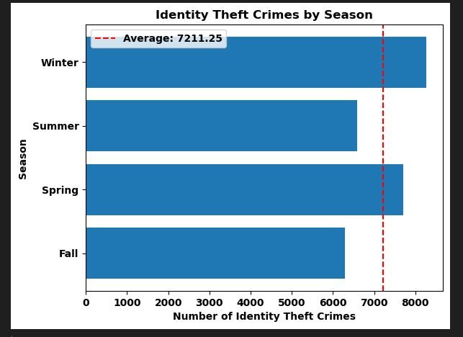
Identity Theft per Season

Slide 17
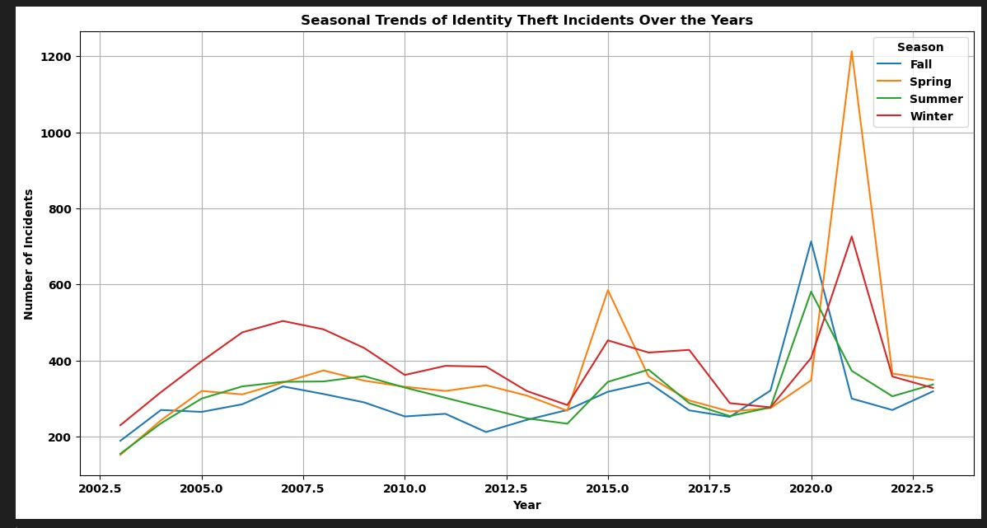
Identity Theft per Season

Slide 18
Test 1: Identity Theft per Season
N0: If seasons are not related to identity theft, then the Winter months will not see an increase in identity theft.
N1: If seasons are related to identity theft, then the Winter months will show an increase in identity theft
Results:
Chi-squared test: 164.8933382489
P-value: 1.6107138924223533e-35
Reject null hypothesis: Seasons are related to identity theft.

Slide 19
Overall Conclusion
Seasons do influence crime in residential burglaries, auto thefts, bicycle thefts, and identity theft.
Seasons do NOT impact shoplifting incidences

